Slide 1
Group-5 : Web Checklist for Surgery Students
Client: Dr. Eliza Beth Littleton : Dept of Surgery
Vishruth Reddy, Shriharsha Vaidhyam, Siddhesh Shimpukade, Sebi Samuel

Slide 2
The idea
Focuses on clerkship rotations of 3rd year medical students .
Rotations involve students to observe surgical procedures in an Operation Theatre
Students(clerks) note down which all procedures they have observed by maintaining a checklist
The idea is just a web version of the existing checklist

Slide 3
Personas
Student : The primary user
Department Administrator : The client
Resident : A cameo

Slide 4
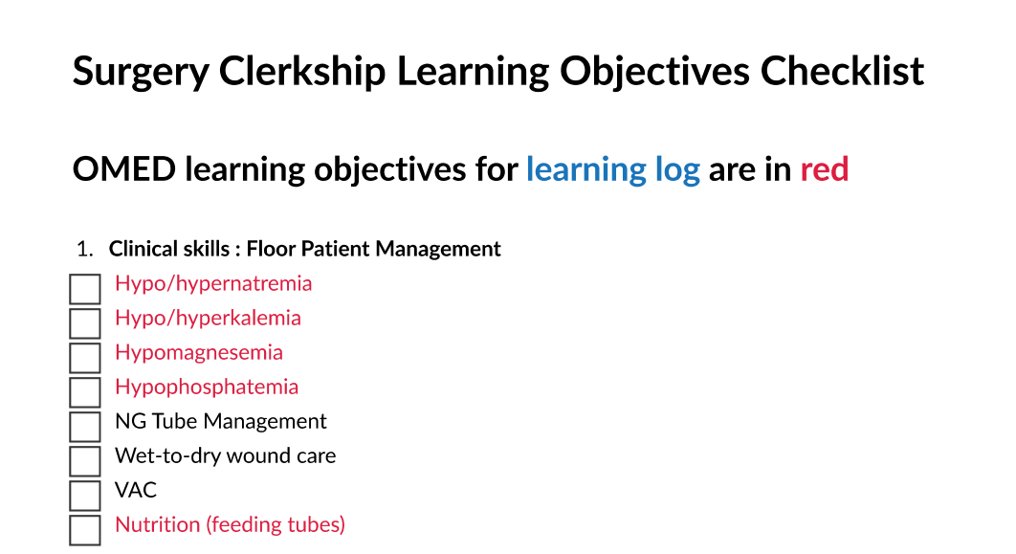
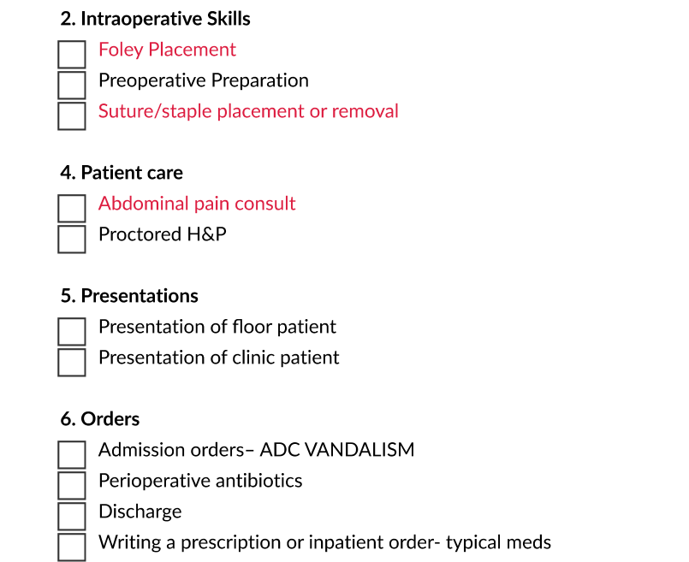
First Prototype: The Genesis

Slide 5
First Prototype : Feedback
Too simple to be used as a web application.
Need a resident’s view and the department admin’s view
Wanted to see progress of the student

Slide 6
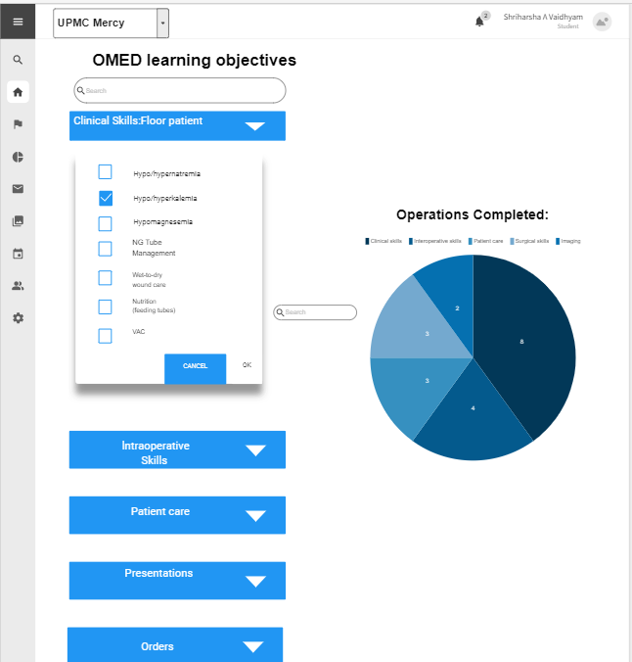
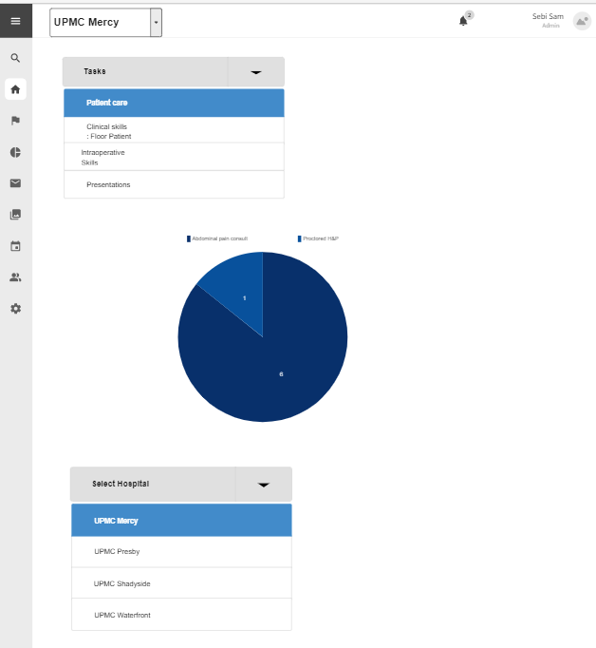
Second Prototype: The Upgrade

Slide 7
Second Prototype: Feedback
Need it as a web app with login
Want to see a page for resident’s view as well
Dept admin should be able to add and remove students
Student should be able to see a separate list for their pending tasks

Slide 8
Final Prototype: The showdown
Made a prototype of the web application. Preferably for desktop/laptops/tablets
Resident clerkship directors view to see the student list and the tasks completed in total.
Department admin can view every student’s progress and can also add/delete students in the list.
Got approval from the client!!

